Slide 1




Beginner ML
GROUP 5
GDGoC UIN JAKARTA
Machine Learning Final Project
Prediksi Analisis MPG Mobil

Slide 2

Beginner ML
GROUP 5
GDGoC UIN JAKARTA
The
Team
Anggita Sakato
Kayasmine Afifa Gunawan
M. Farrel
Aditya
Cinantya
Luthfi Herianda
Syahrul Akbar
M. Amar
Primus
M. Aulia
Addinul
Nabill Nashrullah

Slide 3




Beginner ML
GROUP 5
GDGoC UIN JAKARTA
Our Case
Problem, Condition, Goals

Slide 4

Beginner ML
GROUP 5
GDGoC UIN JAKARTA
Describing Data
Penjelasan cara mendapatkan karakteristik dataset
Key Components
Exploratory Data Analysis
Penjelasan cara mendapatkan hubungan antar data da;a, dataset
Feature Engineering
Strategy to Reach our Goals
Penjelasan strategi mendapatkan fitur beserta cara menghindari masalahnya
Modelling + Evaluation
Penjelasan karakter model + cara mengevaluasinya

Slide 5
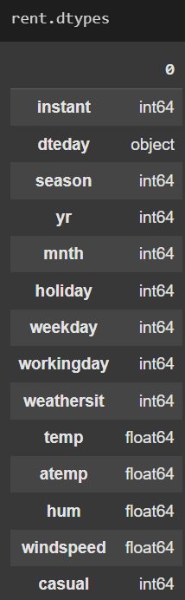
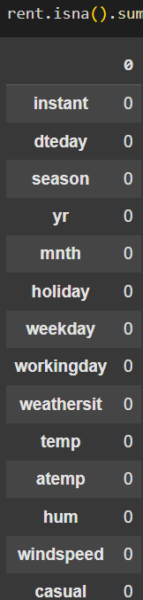
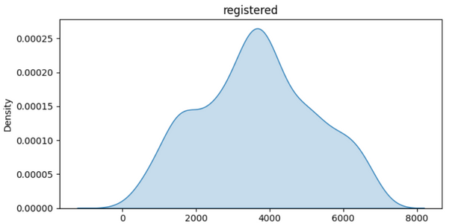
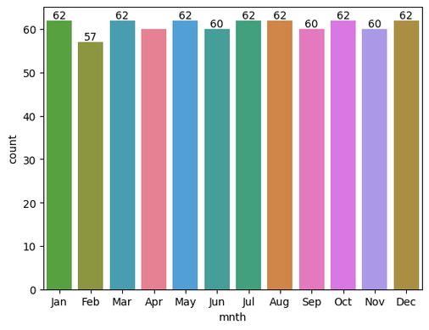
Beginner ML
GROUP 5
GDGoC UIN JAKARTA
Describing Data
Noise Data
Tipe Data
Volume Data
Variabel Target
*Bebas Menggunakan Grafik Apapun

Slide 6
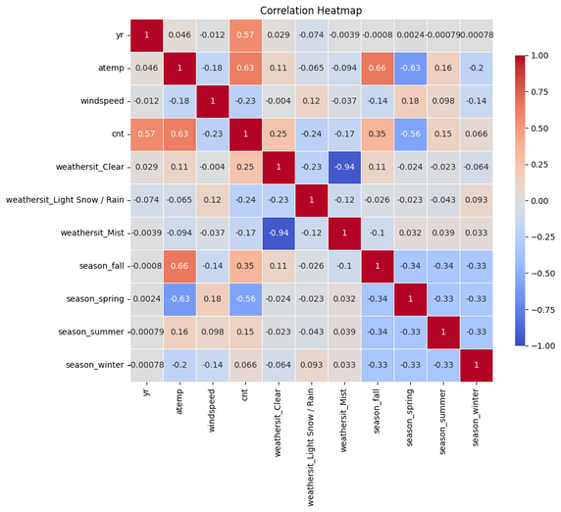
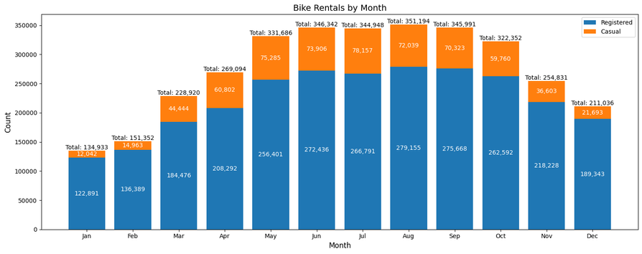
Beginner ML
GROUP 5
GDGoC UIN JAKARTA
Grafik A
EDA
Explain Reliationship Inside the Graphics
Grafik B
*Bebas Menggunakan Grafik Apapun

Slide 7
Beginner ML
GROUP 5
GDGoC UIN JAKARTA
Feature Engineering
🪄Transform
Altering Data Distribution
🧩Imputation
⚖️Scaling
Change Missing Value and Outlier using <descriptive stats>
Balancing value to consistent range (Min-Max, Z-score).
⚙️Modify Data
👥 Clustering
Remove or Modify the data (data types, formatting, etc)
grouping similar data points
📊Encoding
🛡️ Reguralization
converting categories (like text) into structured numerical formats (one-hot, label encoding).
adding penalties (e.g., L1/Lasso or L2/Ridge) to limit complexity

Slide 8
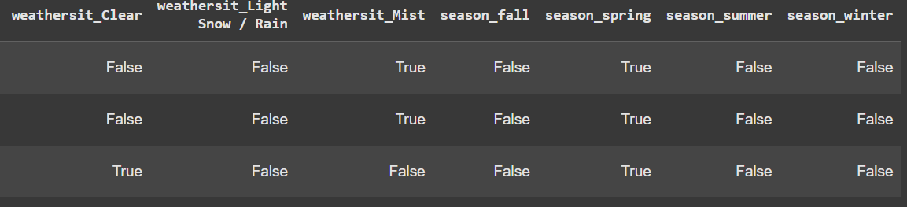
Beginner ML
GROUP 5
GDGoC UIN JAKARTA
Feature Engineering
📊Encoding

Slide 9


Beginner ML
GROUP 5
GDGoC UIN JAKARTA
Model Building
Solution - x%
Strategy implementation + improvisation
Strategy - x%
Strategy to Overcome those problems
Challenges - x%
Challenges when building this model

Slide 10


Beginner ML
GROUP 5
GDGoC UIN JAKARTA
Model Evaluation
Name of Evaluation
Results
Name of Evaluation
Results
Name of Evaluation
Results

Slide 11


Beginner ML
GROUP 5
GDGoC UIN JAKARTA
Model Conclusion
Based on the evaluation and process, give us your opinion on the model

Slide 12
Beginner ML
GROUP 5
GDGoC UIN JAKARTA
Model Usability
In what circumstance the model will be useful. Why we need to create this model

Slide 13
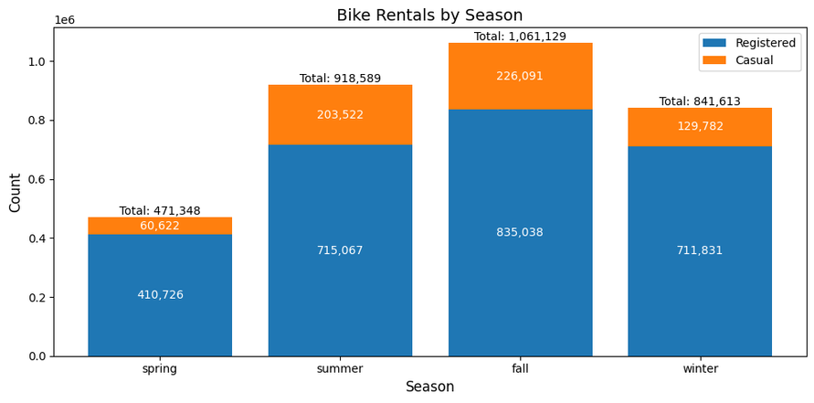


Beginner ML
GROUP 5
GDGoC UIN JAKARTA
Data Analysis
Conclusion Gathered from dataset.
1.
2.
3.
4.

Slide 14


Beginner ML
GROUP 5
GDGoC UIN JAKARTA
Questions? Reactions?
Feel free to get in touch with us.

